Slide 1
ENSF 692 Project
Bo Zheng Ma, Rick Zhang, Warisa

Slide 2
Project Goals
Design and document a terminal-based Python application
Select, import, and manipulate a set of data
Merge multiple datasets using Pandas
Use hierarchical indexing to sort and slice data
Process data according to user input
Operate on data in Pandas and NumPy
Display data using Matplotlib
Collaboration with other programmers

Slide 3
Data Import and Processing
Rick Zhang

Slide 4
Selected Datasets
Cell Phones (Total)
Coal Consumption (Total)
Electricity Generation (Total)
Residential Electricity Use (Total)
Population
Inflation (Annual %)
Total GDP (US$, inflation-adjusted)
Average Daily Income, $/Person/Day, Inflation- & Price Adjusted
Life Expectancy (At Birth)
Number Of People Using Internet

Slide 5
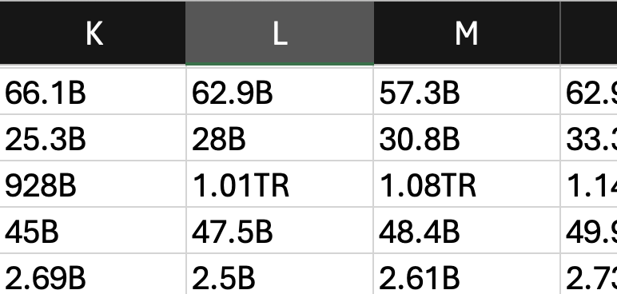
Property of Selected Datasets
Each spreadsheet only contains one category of data.
All datas are in type of string.
Characters are used to represent units.
Unicode \U00002212 is used to represent negative instead of hyphen (-)

Slide 6
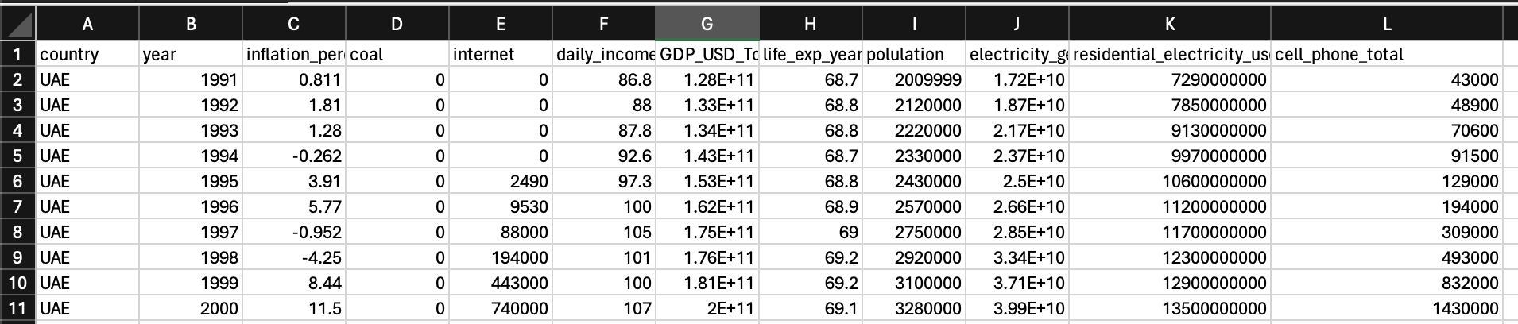
Planned Output For Next Stage
Generate a dataset that contains at least 10 columns and 200 rows.
All value in integer or float.

Slide 7
Solution
Generate a dataset that contains at least 10 columns and 200 rows.
Import and merge 10 spreadsheets.
All value in integer or float.
Use regex to replace unit characters with arithmetic evaluations.
E.g pd.dataframe[data_name].replace({"\U00002212":"-","k":"*1e3", "µ":"*1e-6", "M":"*1e6", "B":"*1e9"}, regex=True).map(pd.eval).astype(float)
Code Reference:
https://www.skytowner.com/explore/converting_k_and_m_to_numerical_form_in_pandas_dataframe

Slide 8
Data Analysis
Bo Zheng Ma

Slide 9
Topics Explored
Cell Phones (Total)
Coal Consumption (Total)
Electricity Generation (Total)
Residential Electricity Use (Total)
Population
Inflation (Annual %)
Total GDP (US$, inflation-adjusted)
Average Daily Income, $/Person/Day, Inflation- & Price Adjusted
Life Expectancy (At Birth)
Number Of People Using Internet
Life Quality
Economy
Technology and Economy
Energy
Digital Infrastructure

Slide 10
Life Quality
Datasets
Life Expectancy
Total GDP (in USD, inflation adjusted)
Number of Cellphones
Internet Users (Average per year)
Analysis: Investigate the relationship between life expectancy and both economic prosperity (GDP) and access to technology (cell phones and internet).
Notes:
Analysis: Investigate the relationship between life expectancy and both economic prosperity (GDP) and access to technology (cell phones and internet). This provides insights into how technological advancements and economic conditions contribute to overall life quality.
We can explore whether regions or demographic groups with higher GDP per capita and greater access to technology also enjoy higher life expectancy.

Slide 11
Economy
Datasets
Total GDP (in USD, inflation adjusted)
Population
Inflation (annual percent)
Analysis: This topic focuses on understanding the dynamics between population growth, inflation, and GDP. We can analyze how population changes influence GDP and inflation rates.
Notes:
For instance, whether a larger population drives GDP growth through increased production and consumption or leads to higher inflation through increased demand for goods and services.

Slide 12
Technology and Economy
Datasets
Number of Cellphones
Internet Penetration Rate
Total GDP (in USD, inflation adjusted)
Daily income
Analysis: We can analyze how the adoption of technology (cellphones and internet) correlates with economic prosperity (GDP and daily income).
Notes:
This can help understand whether technological access is a driver of economic growth, or merely a consequence of it.

Slide 13
Energy
Datasets
Electricity generated (kilowatt hours)
Total Coal Consumption (tonnes oil equivalent)
Net Internet Users (Average per year)
Analysis: We can explore how energy production (specifically electricity and coal consumption) correlates with the proliferation of digital technology. This could reveal whether increases in internet usage drive higher electricity demand, potentially straining energy resources or leading to greater coal consumption.
Notes:
Alternatively, it might show how technological advances lead to more efficient energy use or a shift toward renewable energy sources. Analysis could involve comparing energy consumption rates with internet penetration rates across different regions or time periods.

Slide 14
Digital Infrastructure
Datasets:
Number of Cellphones
Net Internet Users
Electricity generated (kilowatt hours)
Analysis: This group includes indicators related to digital connectivity and technological infrastructure. It provides insights into how well a country is equipped to support and sustain digital activities, which are crucial for modern economies and societies.

Slide 15
Merged Columns
GDP per capita = Total GDP per country (USD Inflation Adjusted) / Population
Internet Penetration Rate = Internet users / Population * 100
Notes:
GDP per capita is a country's economic output to a per-person allocation
The Internet Penetration Rate corresponds to the percentage of the total population of a given country that uses the Internet.

Slide 16
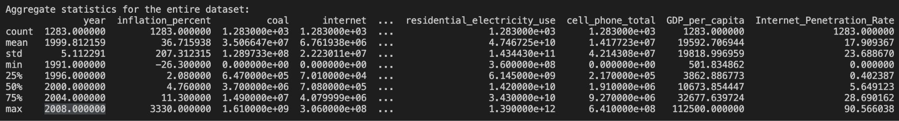
Aggregate Statistics

Slide 17
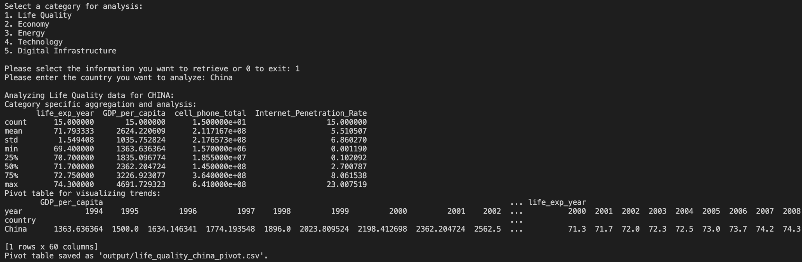
Calculated Statistics

Slide 18
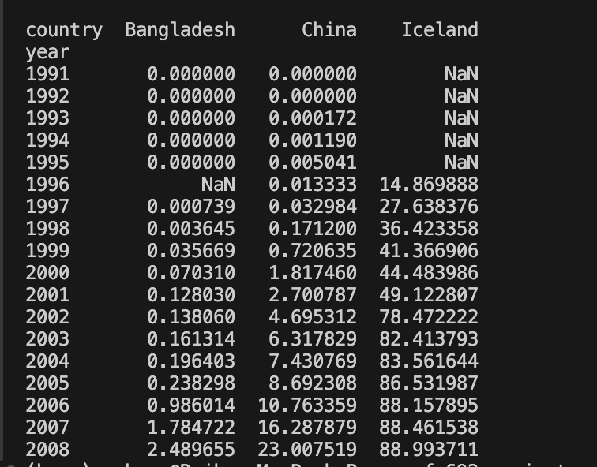
Pivot Table

Slide 19
User Interface and Plotting
Warisa Khaophong

Slide 20
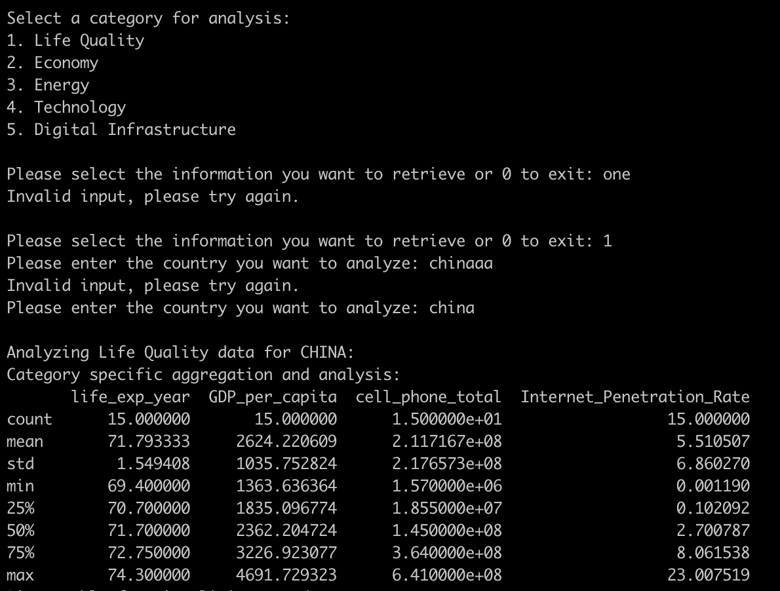
User Interface Flow
Data import
Ask for the first user input. → Topic / Exit
<- Invalid input
<- Invalid input
Ask for the second user input. → Country
Do analysis based on [Topic, Country]

Slide 21
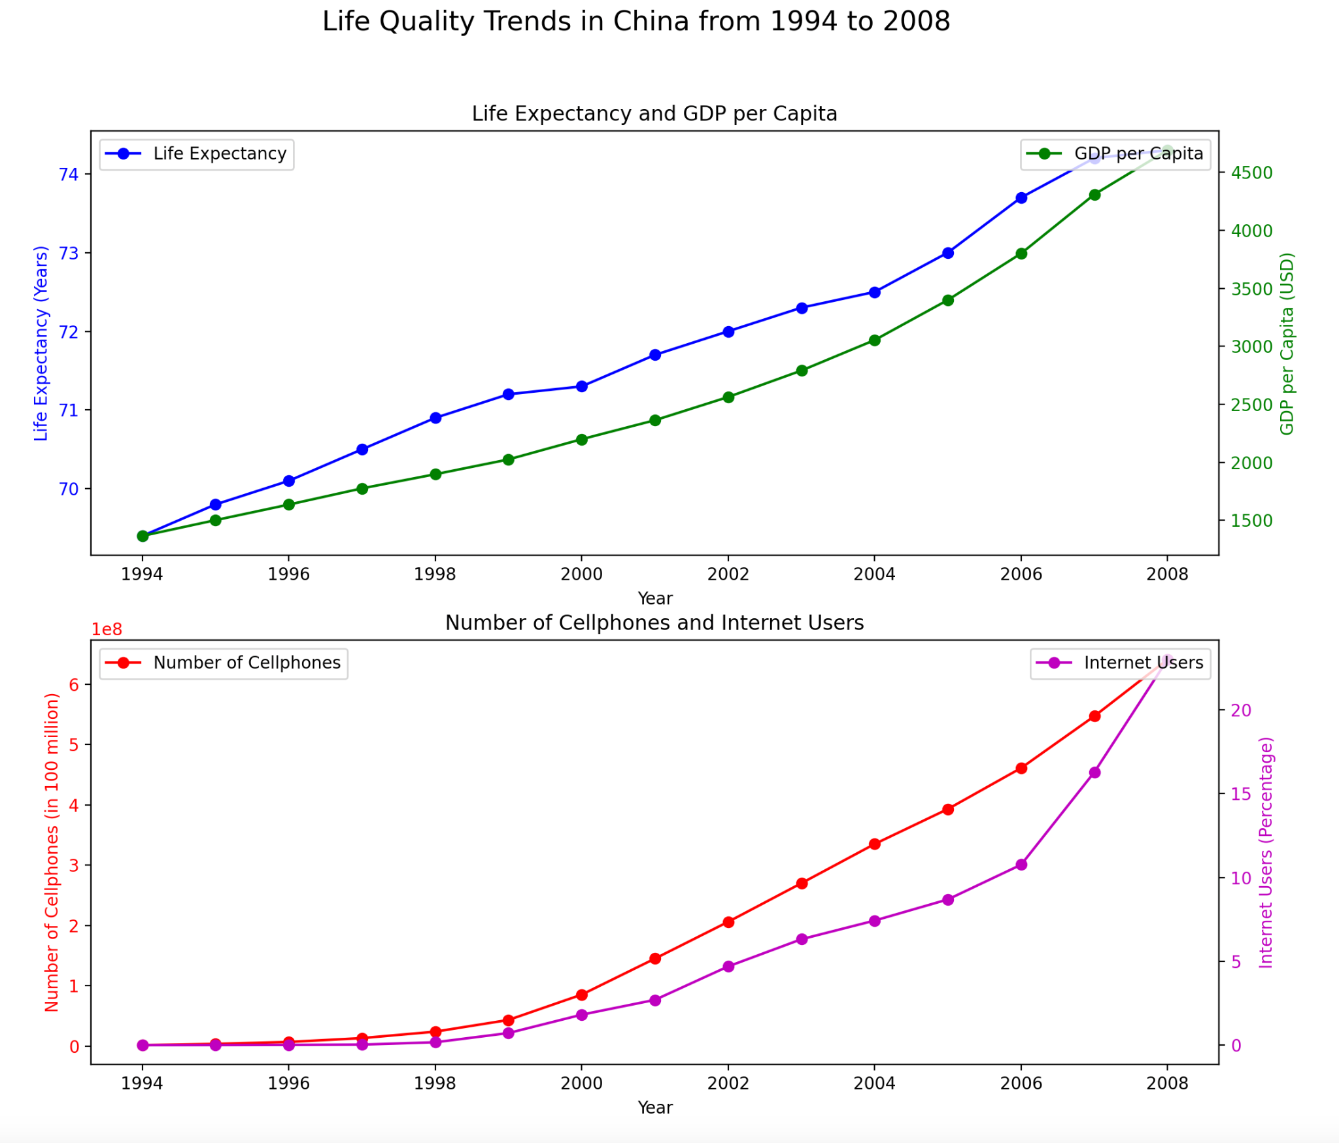
Graph and Insights
Overall Insights:
Positive trends in GDP per capita, cell phone usage, and internet access correlate with the improvement in the life expectancy.
Economic growth and technological advancements contribute to better life quality in China

Slide 22
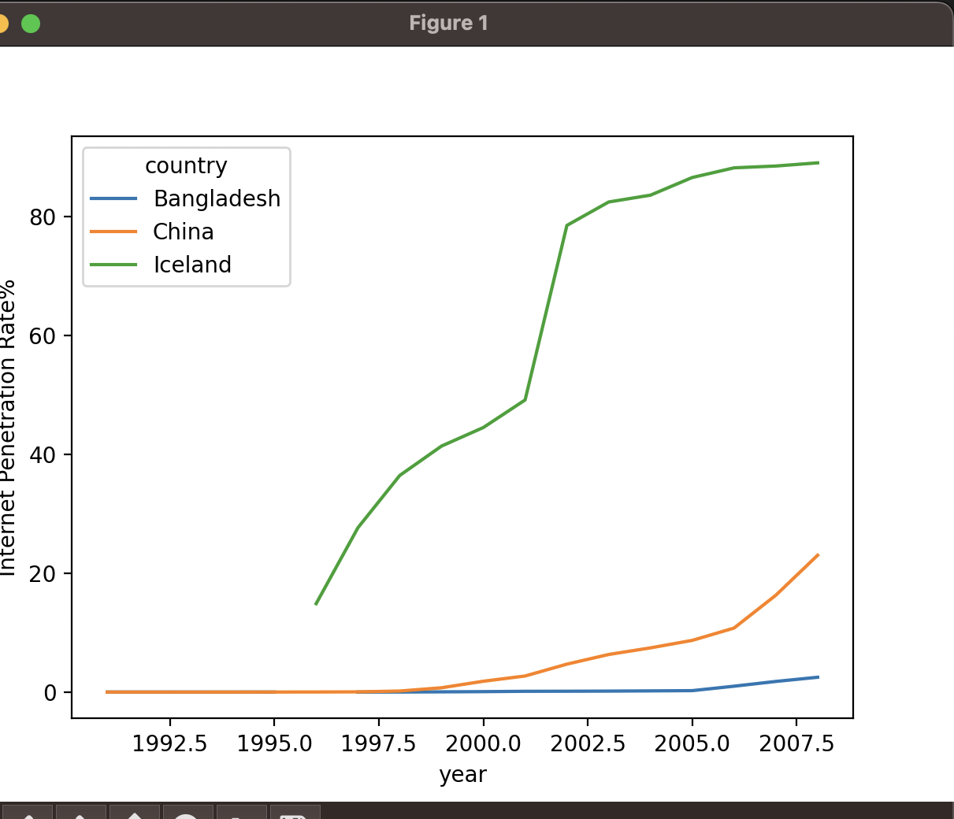
Compare Between Countries

Slide 23
Sources
Dataset:
https://www.gapminder.org/data
Computation:
https://www.skytowner.com/explore/converting_k_and_m_to_numerical_form_in_pandas_dataframe

Slide 24
Thanks for watching!

